Slide 1
Off-target effects of SM HTT Splicing Enhancer (1st & 2nd & 3rd data sets)
HTT Group Meeting
Apr 12, 2023
Zhen, Dann, Catherine, Joon, Magnus, Jessica, Christina

Slide 2
Main Goals Across the 1st 2nd and 3rd RNAseq
Discover the small compounds with fewer off-targets and similar on-target effects through continues medicinal chemistry improvement (by Magnus)
Determine the common targets among the SM splicing enhancers
Confirm the system difference between the different cell-systems (iPSC, NGN2,Sy5Y)
Seek the best procedure for cross-experiments/cross-cell-systems comparison
Make robust and cost-efficient experimental design, QC etc.
Sep 26, 2022
Zhen, Dann, Catherine, Joon, Magnus, Jessica

Slide 3
SM induced DSG in iPSC cells

Slide 4
SM induced DSG in NGN2 cells

Slide 5
SM induced DSG in Sy5Y cells

Slide 6
SM induced DSG in iPSC, NGN2 and Sy5Y cells

Slide 7
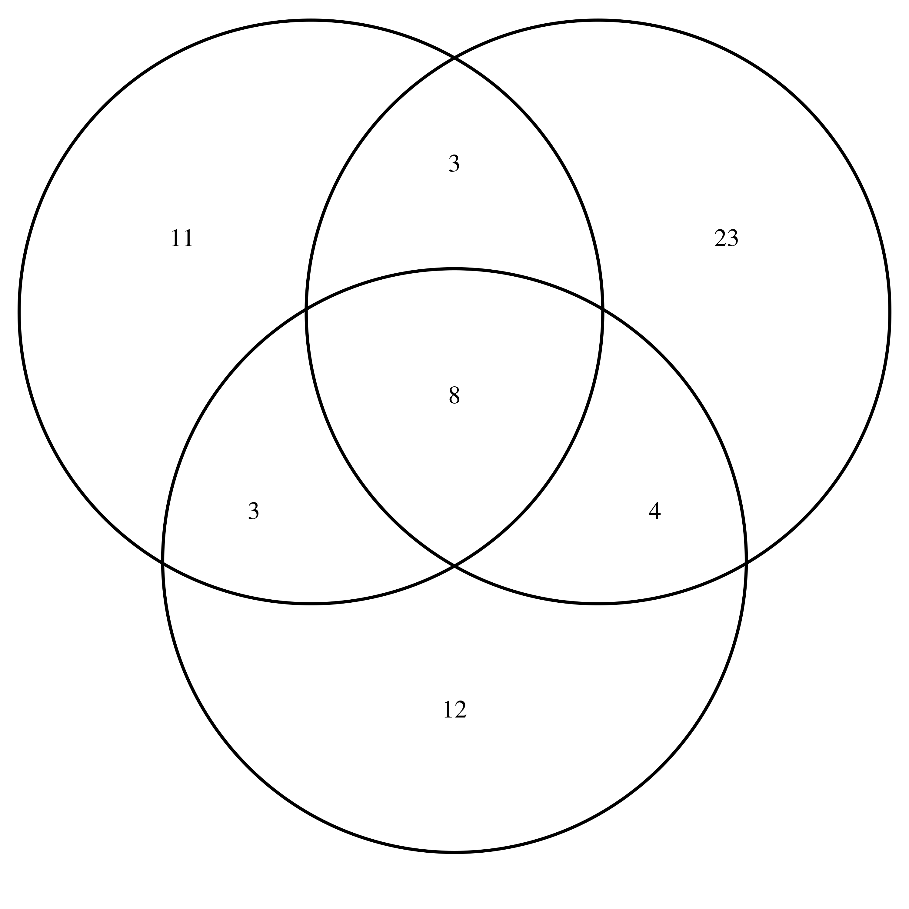
PT518 induced DSG in iPSC, NGN2 and Sy5Y cells
iPSC count:
25
NGN2 count:
38
Sy5Y count:
27

Slide 8
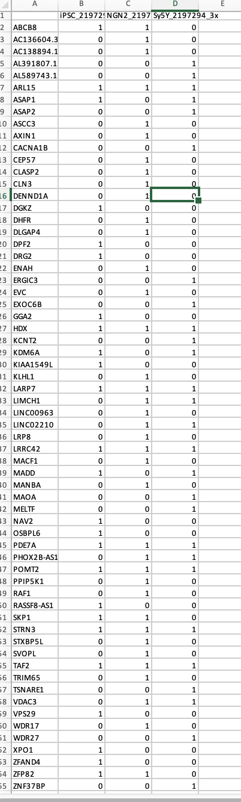
PT518 induced DSG in iPSC NGN2 and Sy5Y cells

Slide 9
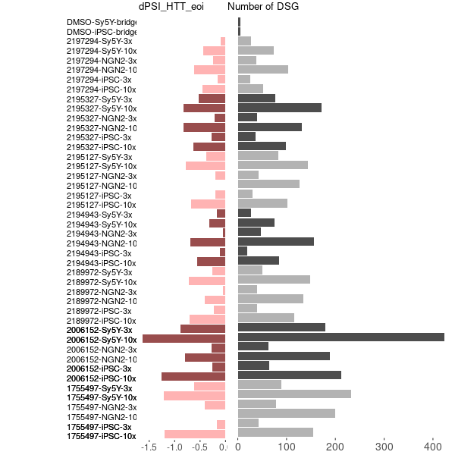
PT518 induced DSG in iPSC NGN2 and Sy5Y cells

Slide 10
DSG and dPSI in eoi

Slide 11
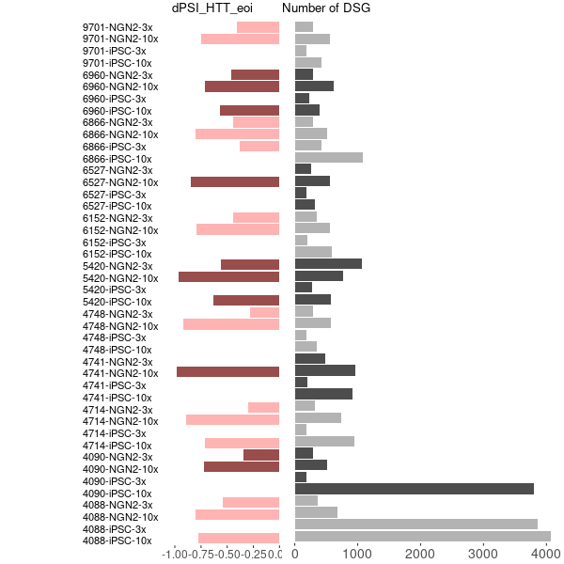
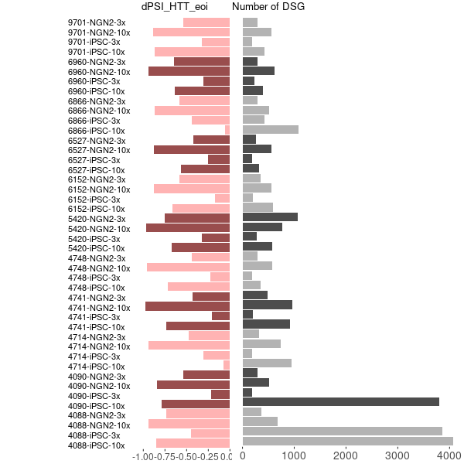
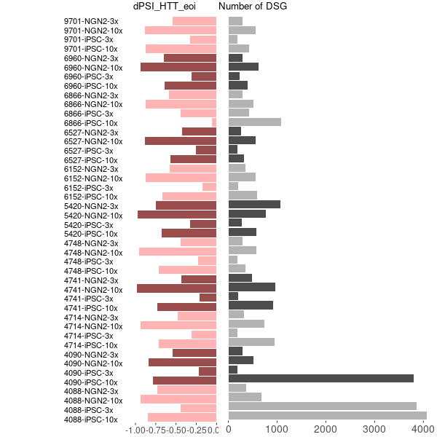
DSG and dPSI in eoi
Updated dPSI from leafcutter
dPSI from majiq
leafcutter majiq merged

Slide 12
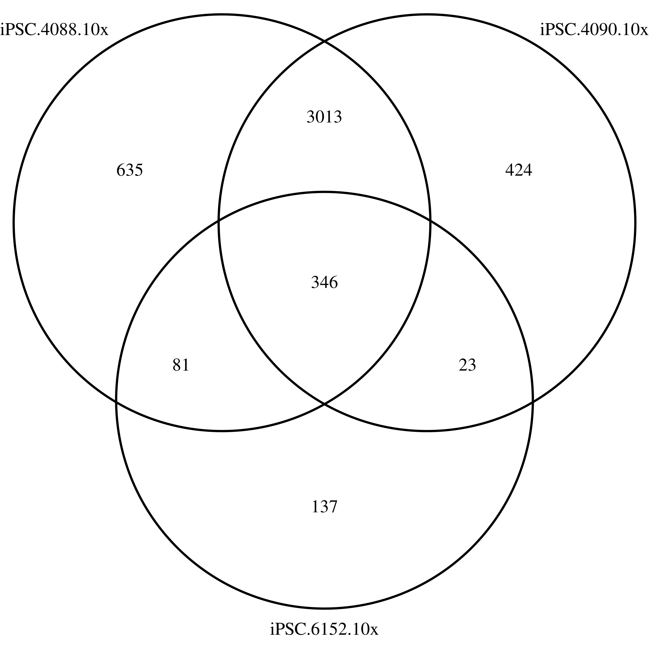
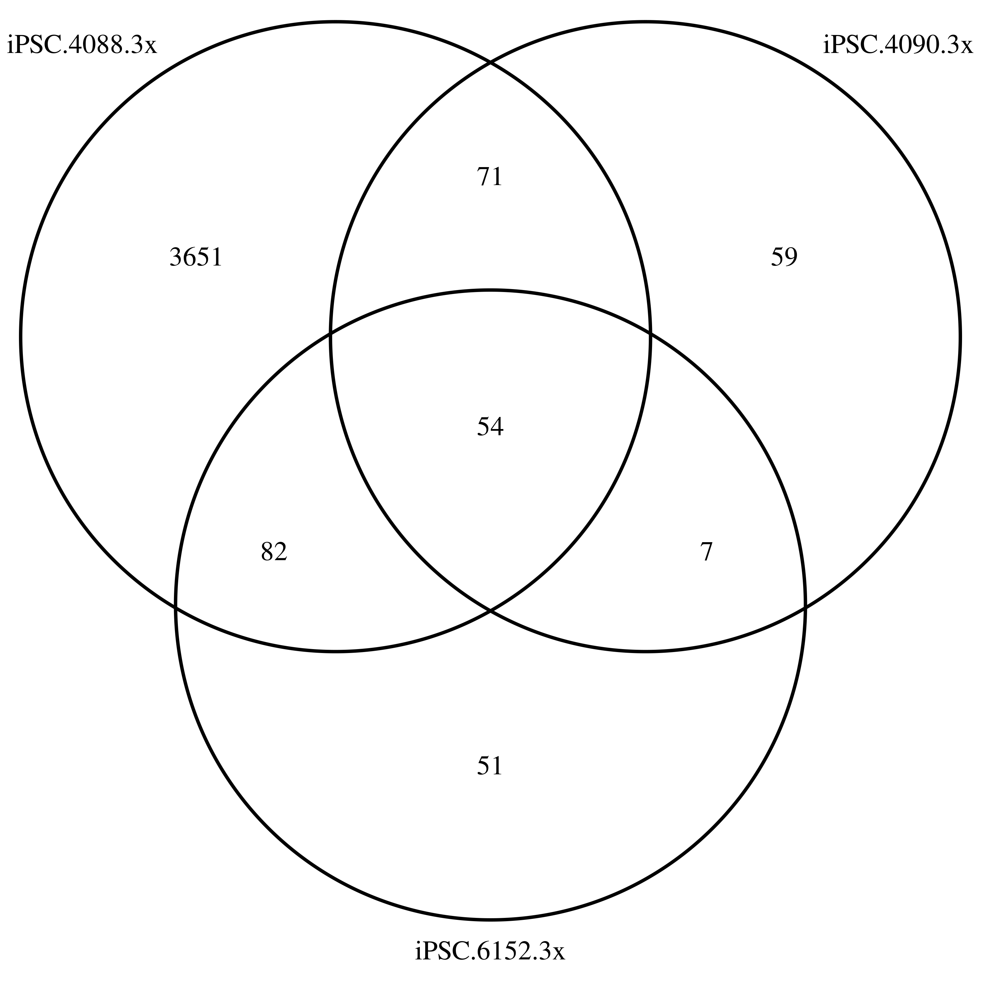
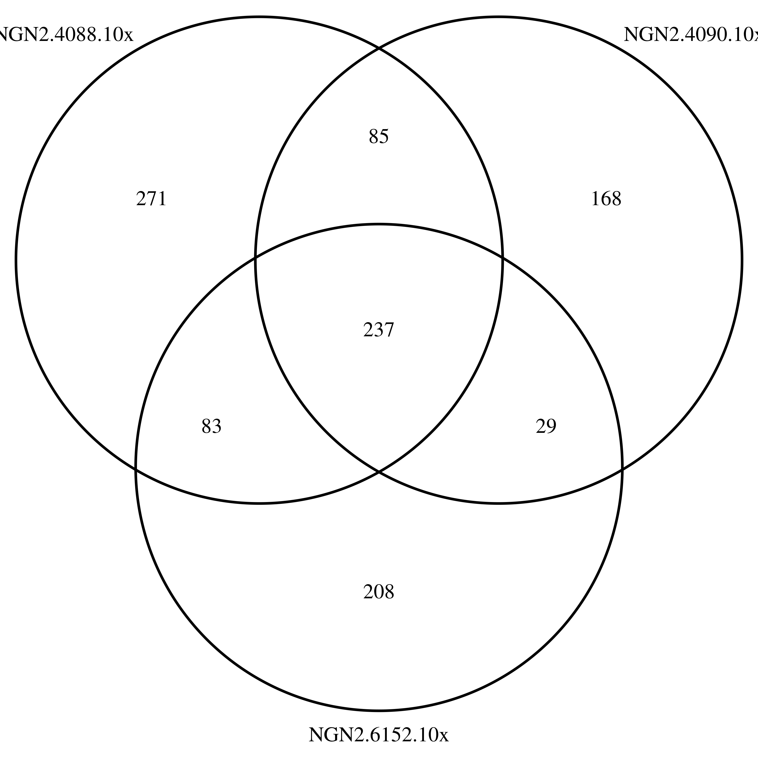
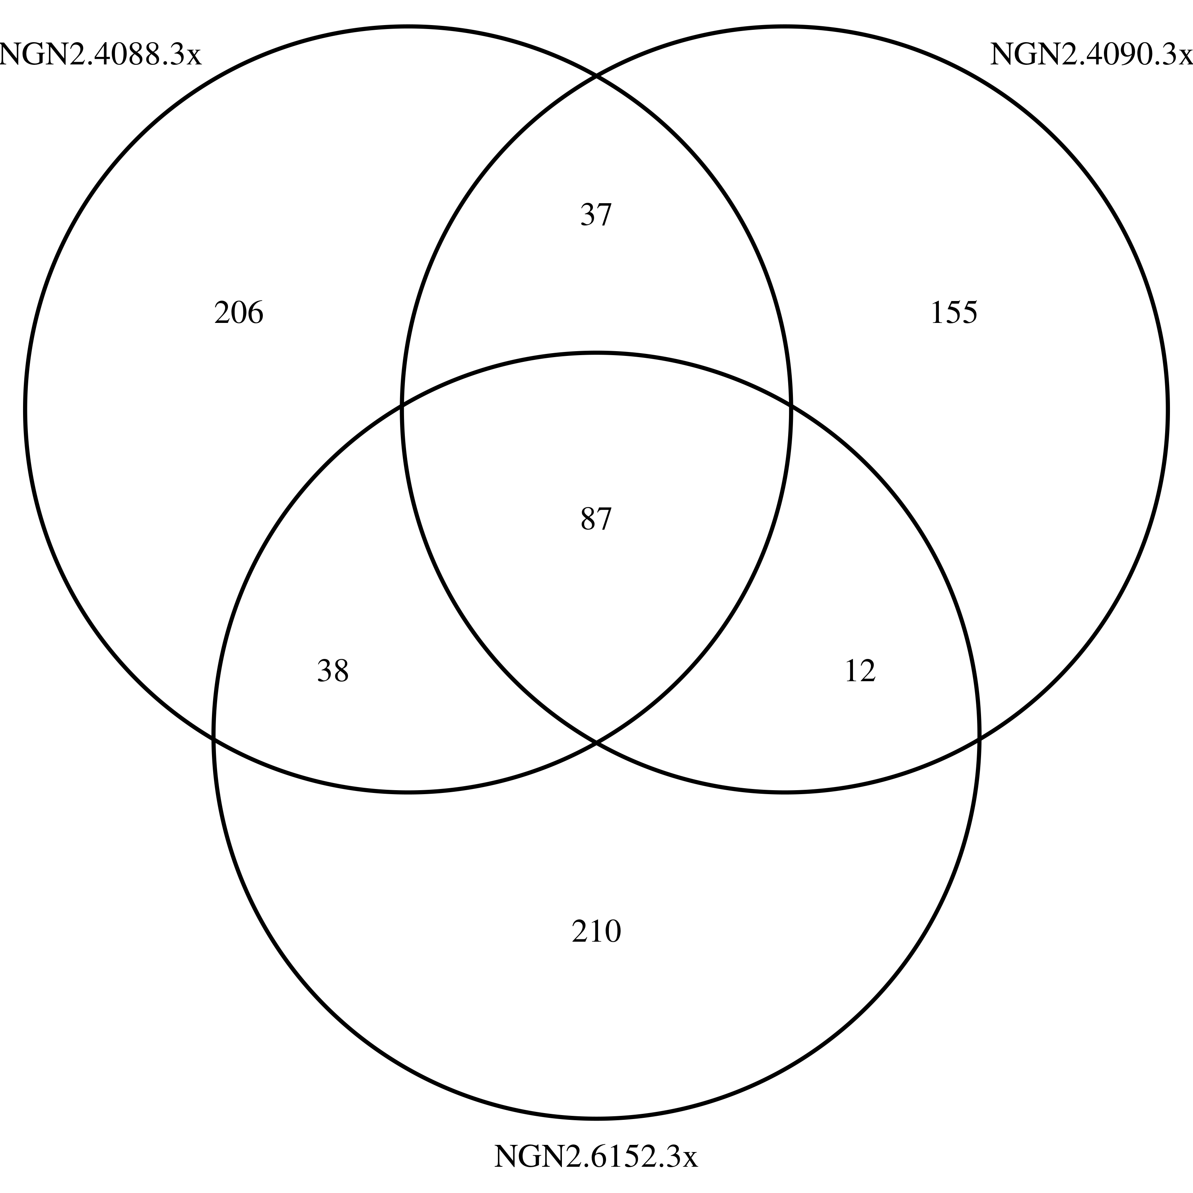
Venn

Slide 13
SM induced DSG in iPSC cells

Slide 14
Main Goals of the Current RNAseq
Discover the compounds have fewer off-targets and keep on-target effects
Determine the common targets among the SM splicing enhancers
Explore potential novel splicing targets
Confirm the system difference between the different cell-systems (iPSC and NGN2)
Seek the best procedure for cross-experiments/cross-cell-systems comparison
Make robust and cost-efficient experimental design, QC etc.
Sep 26, 2022
Zhen, Dann, Catherine, Joon, Magnus, Jessica

